Slide 1
Urban Geography
The Location of Cities
Determining Factors (geographic features, climates) in locating a city. Each city found in waterways(exception Atlanta at a railroad terminus)
Houston (oil,1950s, largest port, largest medical center)
Miami (climate, tourism, Market for specialized goods, Cuban Americans)
Salt Lake City (Mormon to practice their religion)
Vancouver(gateway for import and export, “Hollywood North”)
Washington D C (Capital, Politics, Emergence of United States as world power, Tourist attraction)

Slide 2
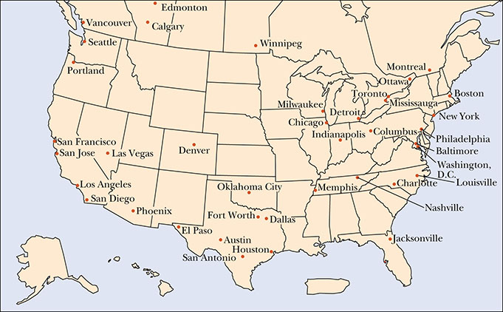
Geographical Location of the Most Populous North American Cities, 2010

Slide 3
Urban Geography
Why Cities Are Where They Are
Environment
Minimally hospitable environment(water) Access to basic requirements(food, water, and building materials)
Limitations can be overcome by technology
Economics (Industrial location theory):port as centers of trade and commerce, lower transportation cost, cheap labor, agglomeration effect, access to market
Social
1)Natural regional crossroads 2) Break-of-bulk points(good are transferred from one type of transportation to another, Houston, Buffalo )3. Access to raw materials, Montreal refinery 4. offer unique amenity(sea, surf, sand, and sun) city, Miami. Las Vegas 5.Administrative city 6. military location, Athens, Quebec 7.religious and education advantage, Salt Lake city

Slide 4
The Shape of the City
The Radiocentric City
Overview
Defense(Athens, Edinburgh, Paris, or Mexico City)
Radiate outward(spread from the center and contained with city walls
The city form was functional because it made travel easier by minimizing the distance to the center of the city( Ancient Baghdad, Ming Peking)
Other factors
Desire to stay close to center
Access roads

Slide 5
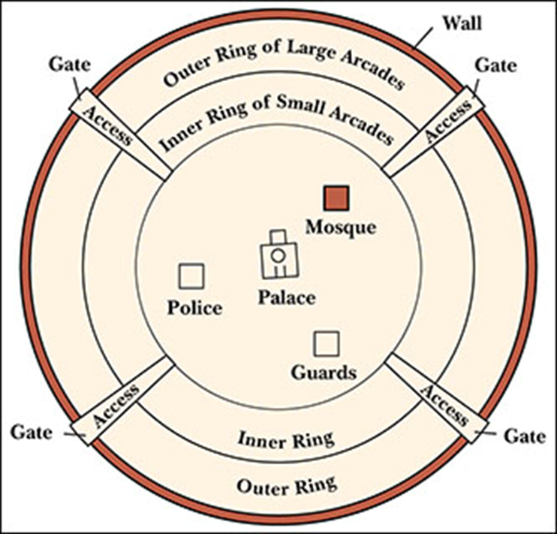
The Radiocentric City: Baghdad, circa 146-762 c.e.
Physical layout
Inner core contains palace and mosque
Two rings of residential quarters
Outer protective wall
Four gates and access roads

Slide 6
The Shape of the City
The Gridiron City
Advantages
Straight streets crossing at right angles to form regular city blocks
After Industrial Revolution
Example – Philadelphia, NYC
Facilitates movement of goods and people and divide the land more easily.

Slide 7
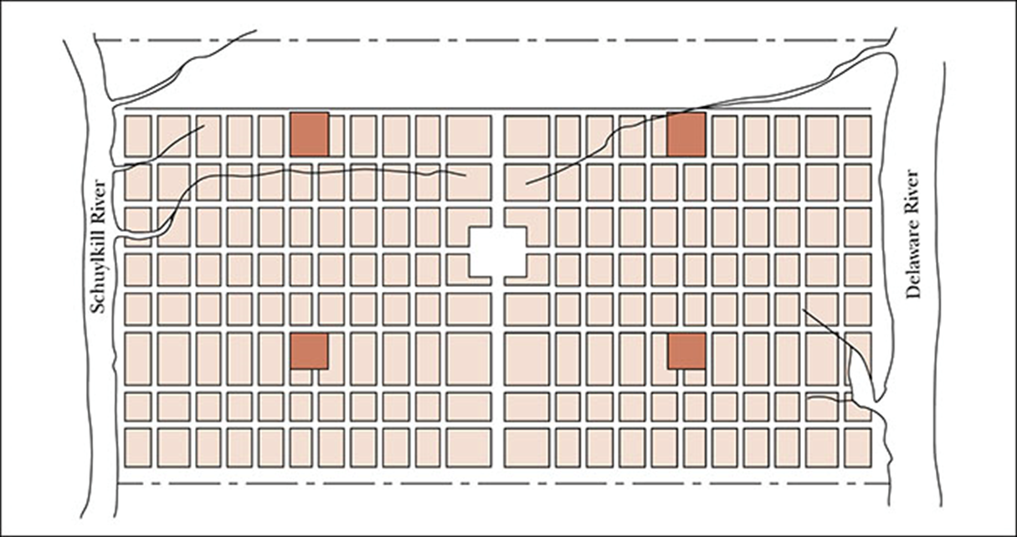
The Gridiron City: William Penn’s Philadelphia Plan, 1682
Non-radial design
Straight streets
Open ended streets
Accessibility
https://www.youtube.com/watch?v=f6U7YFPrz6Y(The New York City Evolution Animation)

Slide 8
Urban Ecology
Concentric Zones
Factors that shape cities
Robert Park--competition and population movement shape and reshape cities.
1) Social life is characterized by economic competition over scarce resources and political competition over neighborhood.
2) population movements produce an invasion-succession effect as poorer and less skilled new immigrants come in and more successful groups move to other neighborhoods.

Slide 9
Urban ecology(Ernest Burges)
Ernest Burgess, one of Park’s students, argues that the city expands outwards in a series of concentric zones from its central business district. Economic competition as well as prestige are the main forces of this urban development. Using Chicago as an example, Burgess distinguishes between five main zones:
(1) the central business district;
(2) an area in transition, which includes light manufacturing, ethnic communities, and slums;

Slide 10
Urban ecology(Ernest Burges)
3) a zone of workingmen’s homes inhabited by second-generation immigrants escaping the slums;
(4) a residential zone with apartments and restricted single-family dwellings; and
(5) a commuters’ zone furthest from the city. This model, Burgess argues, could describe any city.

Slide 11
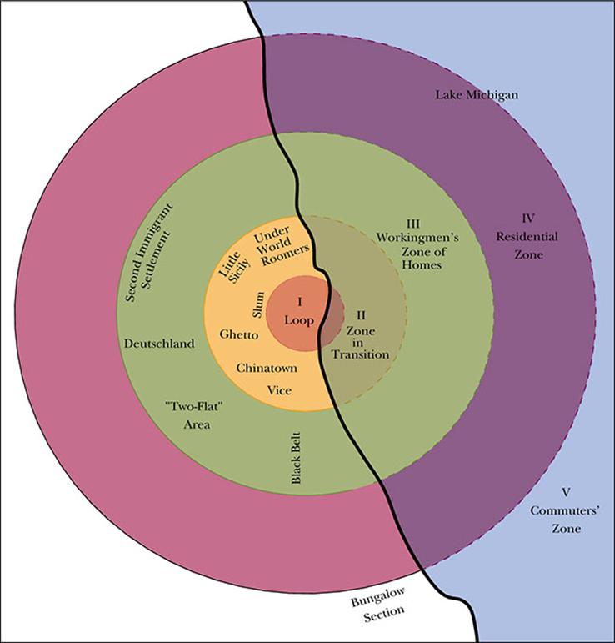
Chicago’s Concentric Zones
Zone I – Loop
Zone II – Zone in transition
Zone III – Zone of workingmen’s homes
Zone IV – Residential area
Zone V – Commuter’s zone

Slide 12
Urban Ecology
Hoyt’s findings
Hoyt (1939), suggests that cities are divided into pie-shaped residential sectors rather than strictly concentric zones. Several upscale residential districts surrounded by poorer areas were found in most cities. Hoyt suggested that over time, sectors moved out radially along paths they had begun in earlier years and that competition and population movements were not always responsible for the location of sectors.

Slide 13
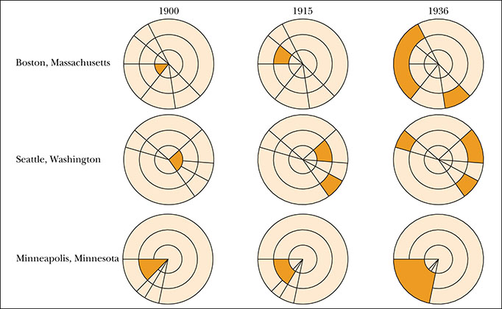
Shifts in the Location of Fashionable Residential
Indicates the shift of high-prestige sector locations in Boston, Seattle, Minneapolis
Shaded portions indicate the high-prestige sector locations

Slide 14
Urban Ecology
Multiple Nuclei
Chauncy Harris and Edward Ullman’s argument(1945)
Through time
Diversification of modern cities
Development of distinct sectors of activity
For example, the relocation of heavy manufacturing from central business districts to outlying areas reflects the desire to minimize the cost of land and taxes.

Slide 15
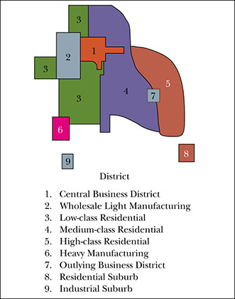
The Multiple Nuclei Theory
Figure explains multiple nuclei theory
Central business district is indicated
Eight distinct sectors around CBD are indicated

Slide 16
Evaluation
Burgess assumed his concentric zone model would describe any city, but this pattern of urban growth tends to occur among industrially based, older, larger, and more dispersed metropolitan communities. Both Hoyt’s sector theory and the multiple nuclei model are critiqued for providing a descriptive analysis of land use within cities.

Slide 17
Evaluation
In general, these models are limited because they suggest uniformity within zones and rely on the concepts of unrestrained competition and large population movement to explain growth patterns.

Slide 18
Evaluation
Consequently, they ignore the impact that forces such as globalization, technological advances, communications, and transportation can have on a city’s spatial development. The urban ecological approach is often seen as too biological because it negates the impact of choice, culture in the city, and community

Slide 19
The Economics of Land Use
Central Place Theory:
Creation of new things: promotes “Interaction and fusion”(Mumford)
In the “downtown,” one finds the greatest economic advantages that cities can offer
Economic advantage
1) Goods availability: oil transport to Albany, NY vs small town
2) Agglomeration industries: the concentration of interrelated businesses(Nashville, LA)
3) Competition: keep cost down, quality up
4) Large available workforce, Large pool of customers
Urban hierarchy
Increase in population: central place theory(W Christaller), The more important a city’s economic function to a region, the more its population will increase and respect each other’s market “distance interval.” (Buffalo, Rochester, Syracuse)

Slide 20
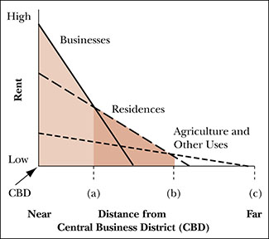
The Economics of Urban Land Use
Distance from CBD in x-axis
Rent in y-axis
High rent near CBD
Business ceases no matte how low rents are
No city workers to live there no matter how low rents are
No agriculture near CBD

Slide 21
The Economics of Land Use
General Patterns of Land Use
Alonso’s model: Poor people live near CBD even though rent is higher close to CBD because high transportation cost. They live in high-density housing, rent control apartment. However, gentrification can move them out. On the other hand, more affluent people can afford more space and fewer poor neighbors.

Slide 22
The Economics of Land Use(Criticism)
Consumer Powerlessness (Rather powerful economic interest against the well-being of the majority)
Noneconomic Factors(resist any ”undesirables” to move nearby, oppose low-income housing)
Nonuniversality(It only applies to mercantile and industrial cities)
Thus, It has limited utility, much reliance free market model

Slide 23
Social Area Analysis and Mapping
GIS (Geographic Information System) Mapping
Computer-based method
Facilitates data gathering, transformation, manipulation, analysis
Valuable resources in land-use management and planning for future development
Application
Private and public sectors
Example- land use management

Slide 24
Social Area Analysis and Mapping
Drawbacks
Not theoretical
Cannot predict or explain things
Limited insight
However,
Possibilities for urban use
Its utilities for a systemic measurement of complexities (better understanding of neighborhood characteristics)

Slide 25
The Los Angeles School: Postmodernism
Emerged in the mid-1980s.
Originally focusing on LA, Ventura, San Bernadino, Riverside, and Orange, its emphasis on multicentered, dispersed patterns as the new reality of urban growth.
They are in favor of more limited interpretations of specific areas rather than universal truth.
Rayner Banham (LA area):
Surfurbia(the beach cities)
The foothills(Beverly Hills and Bel Air)
The Plains of Id(the endless central flatlands)
Autopia (freeway)

Slide 26
The Los Angeles School: Postmodernism
Douglas Suisman’s concept (1990): Boulevards are the defining element of the city’s public space in its linkage between municipalities(structure and community), not freeways.
Edward W. Soja’s view: LA is decentralized metropolis with a fragmented power structure that is becoming increasingly flexible and disorganized (LA as “agglomeration of theme park”). Future urbanism will resemble LA.
Main Arguments(2000)
Michael J. Dear’s notion: “decentered politics”, “split many separate fiefdoms, with their leaders in constant battle.”
Proponent’s notion(previous urban theory is obsolete).

Slide 27
The Los Angeles School: Postmodernism
Criticism:
Advocates(Postmodern) argue that LA resembles low-density growth, multiple ethnic enclaves, and multiple unban centers within one region.
However, LA Schools overemphasize the uniqueness, importance, or widespread applicability of the Los Angeles model.
Need to rise above time and place.

Slide 28
Summary: Spatial Perspectives
Factors for locating cities: environmental conditions were favorable in addition to economic factors, political, religious, and educational factors.
Industrial location theory (minimal cost of transportation, labor, and market) to maximize profit.
Shape of cities(radiocentric, gridiron…)
Robert Park and Ernest W. Burgess concept(competition, population movement, concentration zone model)
Homer Hoyt’s concept(sector based on social economic status)
Harris and Ullman (Urban design, land-use planning, and policy reform, environmentally-sound neighborhood)
Alonso(Urban land use), Social analysis model(GIS mapping).
Postmodernism(political fragmentation, multiple urban centers,, multicultural/multiethnic communities affected by global capitalism

Slide 29
Conclusion: Spatial Perspectives
Urban land use
Major advances
External forces

